Slide 1


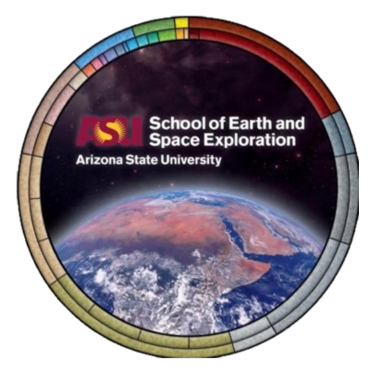
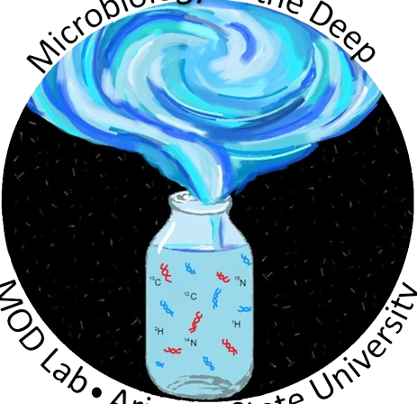

Cell Morphological Changes with Temperature
Hayden Ferrell
Mentors/Advisors; Chanel Vidal and Dr. Elizabeth Trembath-Reichert
ASU School of Earth and Space Exploration
Arizona Space Grant Symposium
2023-2024

Slide 2
Surface Area vs. Volume Changes
  Radius: 3x
  Surface Area: 9x
  Volume: 27x
  Radius: 2x
  Surface Area: 4x
  Volume: 8x
Notes:
-main idea is they do not change at the same ratio
-base idea from the first year of biology
-important to think about when under stressed conditions, what is the most beneficial change when this is considered?
-have a greater surface area/volume ratio, then a cell can accept more nutrients from around it to sustain itself

Slide 3
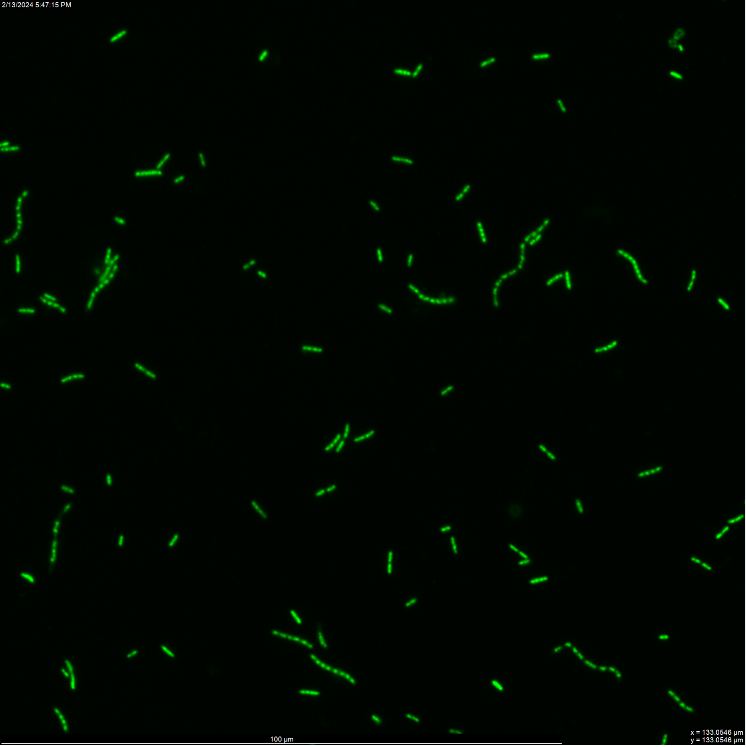
Pseudomonas Putida
Mesophilic Soil Bacteria
Well Researched Bacteria
Optimal Growth Temperature of 30C
  Observed to grow up to 4C
Topic has limited preexisting research
(Fonseca et al., 2011)

Slide 4
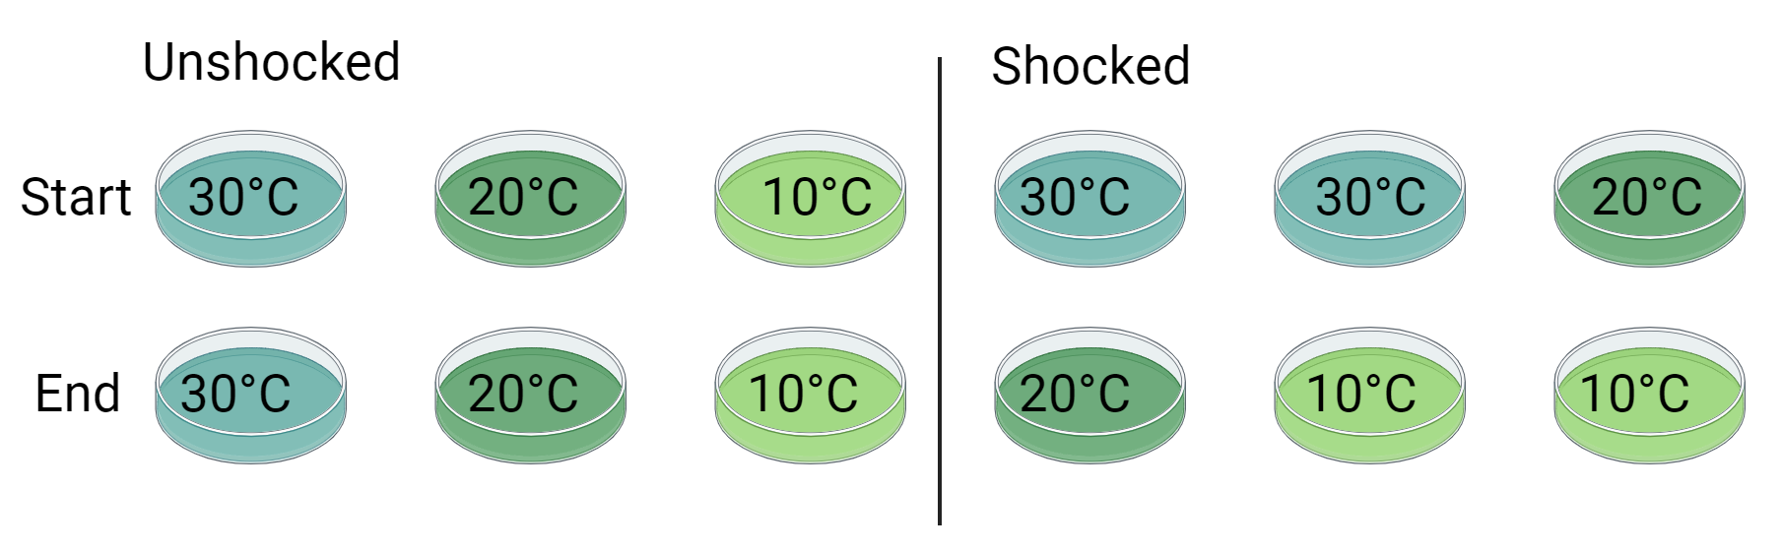
The Experiment
Image Made with BioRender 2024
Notes:
-Ran in triplicate and also tested shaken vs. unshaken. Collected Data at 15 time points throughout the experiment

Slide 5
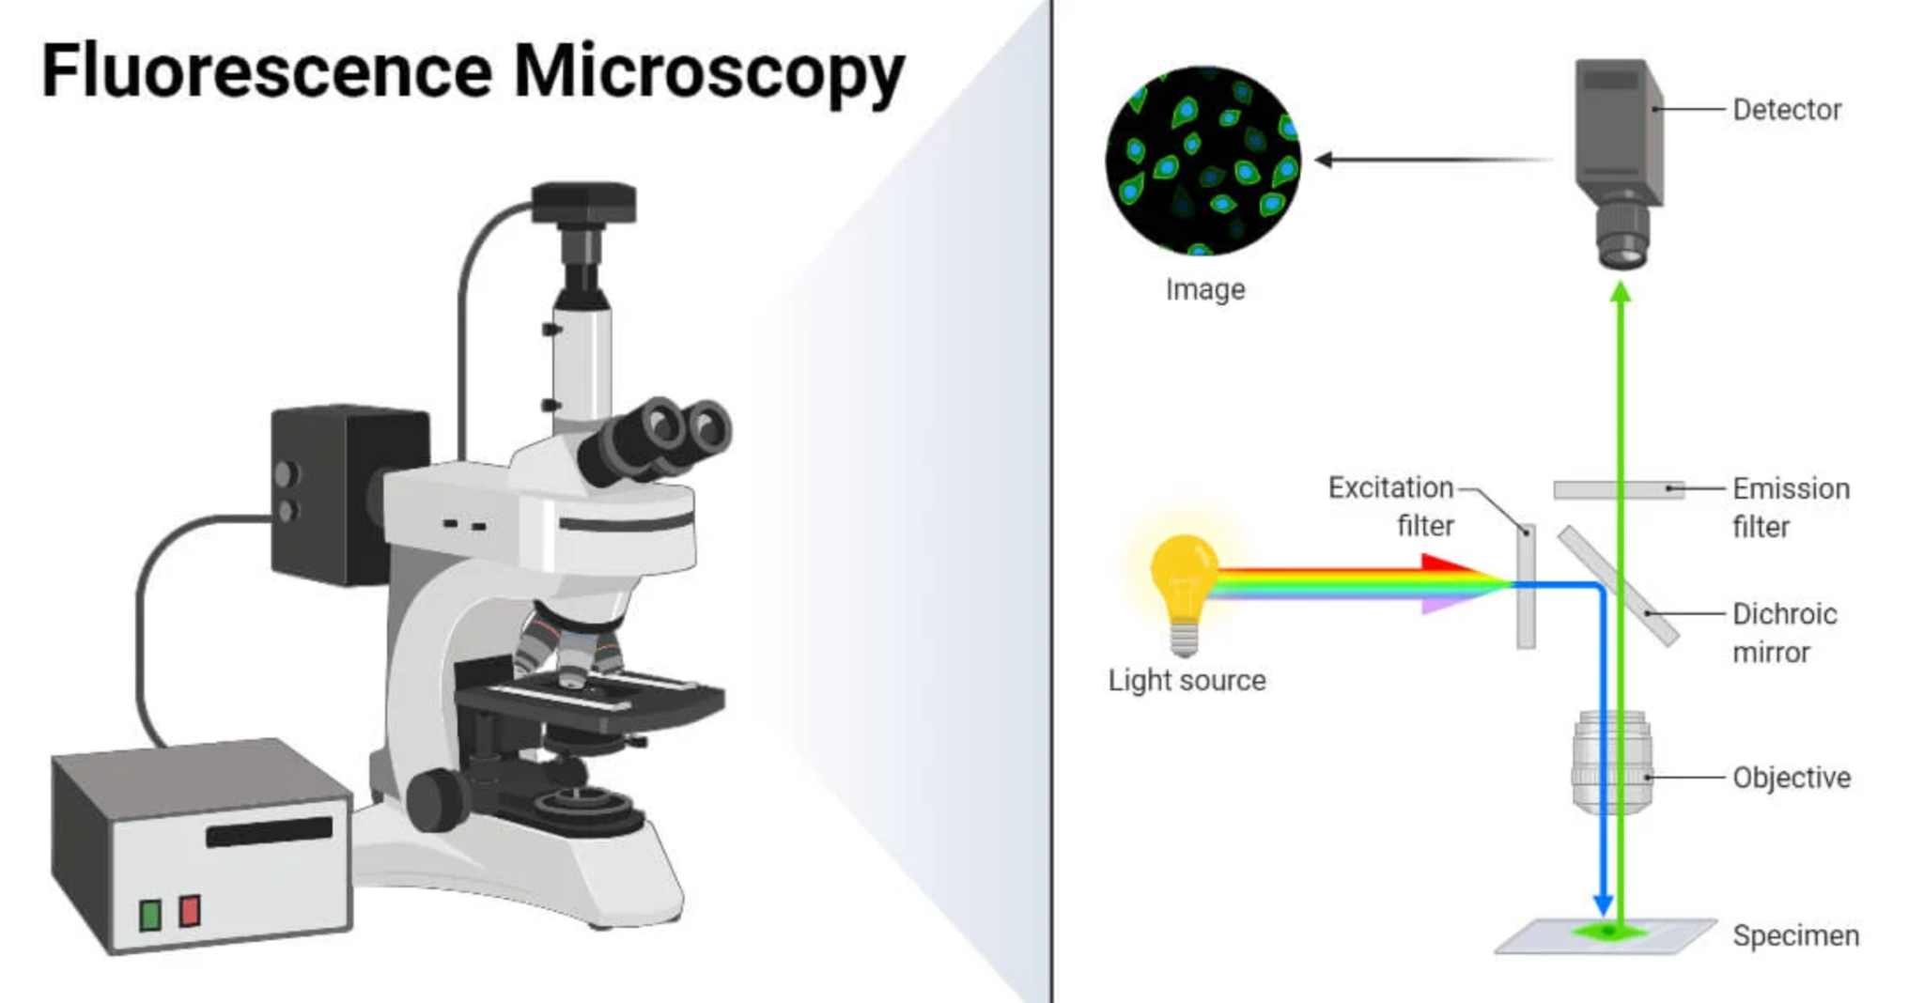
Data Collection
Optical Density
Cell Counts
Fluorescence Microscopy
(Aryal et al., 2022)
Notes:
- Talk about issues with the microscopy and learning how to make filters

Slide 6
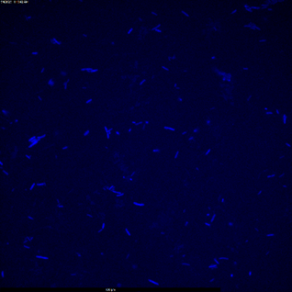
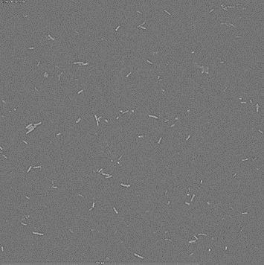
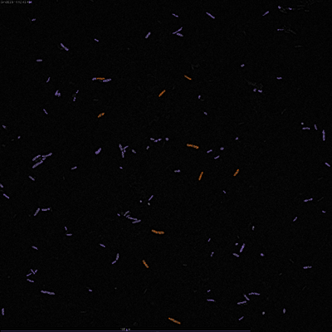
Data Analysis
A
B
C
Figure 1: Displaying the software editing process. A) is the raw image from the microscope. B) is the image after isolating the image into a grayscale image, and removing the vignette. C) is the image after automatically detecting for objects (cells). From here, cell can be filtered, and imposters can be removed from the selected image. From here, the image data can be exported.
Notes:
Due to large amount of data, an image processing pipeline was developed using DAIME
Talk about issues with this process
Also attempted with OpenAI Chat GPT, but there were issues with Chat GPT being able to view photos

Slide 8
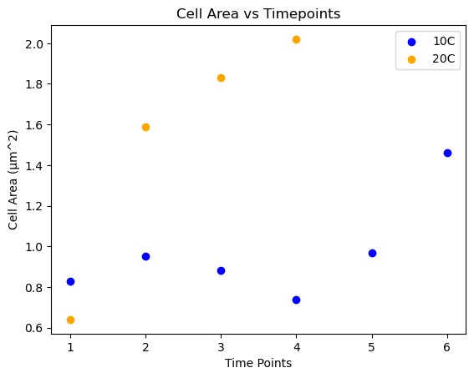
Figure 2: Plot showing preliminary practice on early samples with the processing pipeline, displaying what some of the data could look like.

Slide 9
Astrobiology Connections/Future Plans
Understand poly-extreme conditions (cold and dry)
Antarctic Samples as a Mars Analog
  Antarctic dry perma-frost

Slide 10
Acknowledgments
Thank you to Chanel Vidal and Dr. Elizabeth Trembath-Reichert for supporting me through this project and providing unparalleled guidance. Thank you to Simon Fronmueller for continued peer advice through this Space Grant Internship. Thank you to the MOD lab group for all of their advice and support. Thank you to the Space Grant Foundation for this opportunity. Thank you to the organizers of this symposium for the ability to present what I have been working on thus far. Thank you to Tom Sharp and Desiree Crawl for organizing the ASU Space Grant program and supporting me along with other interns this year.

Slide 11
Thank you for your time!

Slide 12
Citations
Fonseca, P., Moreno, R., & Rojo, F. (2011). Growth of pseudomonas putida at low temperature: Global transcriptomic and Proteomic analyses. Environmental Microbiology Reports, 3(3), 329–339. https://doi.org/10.1111/j.1758-2229.2010.00229.x
Aryal, S., Dagne, A., Hassan, A. B., Sushma, Nadaf, D., Venkatramaiah, & Veenakhuranakumari. (2022, May 12). Fluorescence microscopy- definition, principle, parts, uses. Microbe Notes. https://microbenotes.com/fluorescence-microscope-principle-instrumentation-applications-advantages-limitations/

